Slide 1
Section 9.5
Simple Harmonic Motion;
Damped Motion;
Combining Waves
Copyright © 2012 Pearson Education, Inc. Publishing as Prentice Hall.

Slide 2
Copyright © 2012 Pearson Education, Inc. Publishing as Prentice Hall.

Slide 3
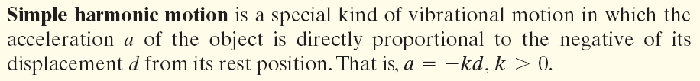
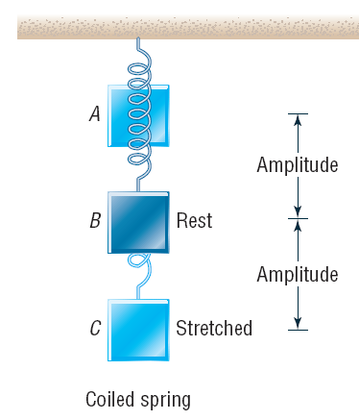
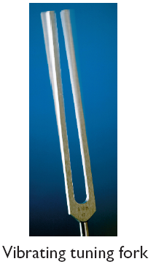
Copyright © 2012 Pearson Education, Inc. Publishing as Prentice Hall.

Slide 4
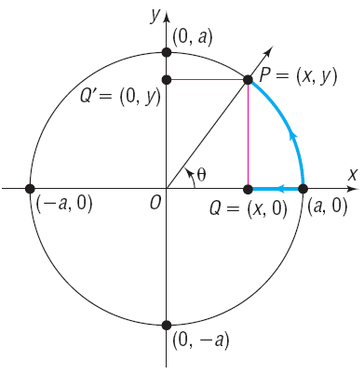


Copyright © 2012 Pearson Education, Inc. Publishing as Prentice Hall.

Slide 5
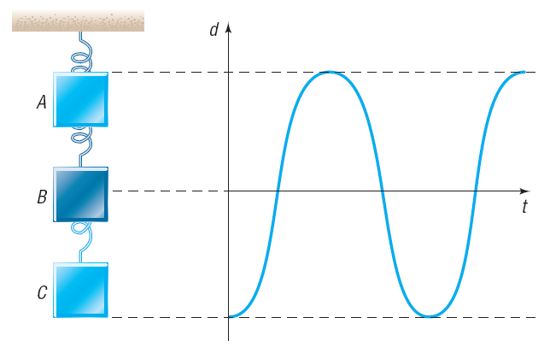
Copyright © 2012 Pearson Education, Inc. Publishing as Prentice Hall.

Slide 6

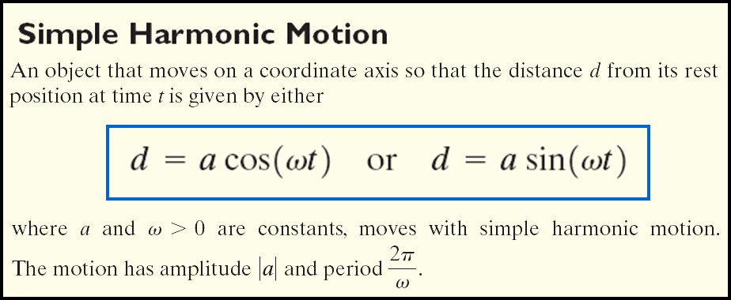

Frequency
Copyright © 2012 Pearson Education, Inc. Publishing as Prentice Hall.

Slide 7

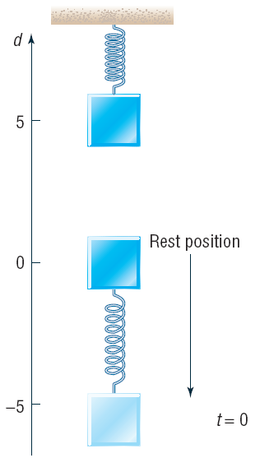


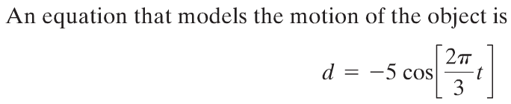
Suppose that an object attached to a coiled spring is pulled down a distance of 5 inches from its rest position and then released. If the time for one oscillation is 3 seconds, write an equation that relates the displacement d of the object from its rest position after time t (in seconds). Assume no friction.
Copyright © 2012 Pearson Education, Inc. Publishing as Prentice Hall.

Slide 8
Copyright © 2012 Pearson Education, Inc. Publishing as Prentice Hall.

Slide 9
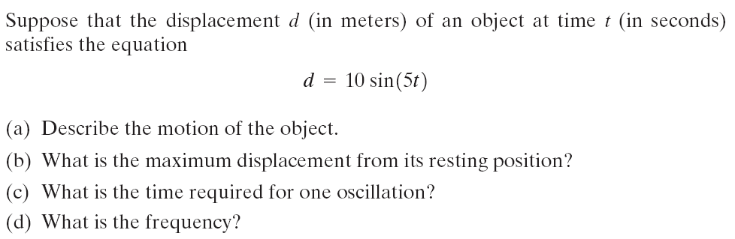

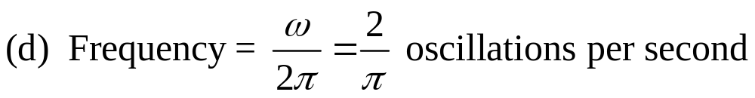
d = 25 cos (4t)
Copyright © 2012 Pearson Education, Inc. Publishing as Prentice Hall.

Slide 10
Copyright © 2012 Pearson Education, Inc. Publishing as Prentice Hall.

Slide 11

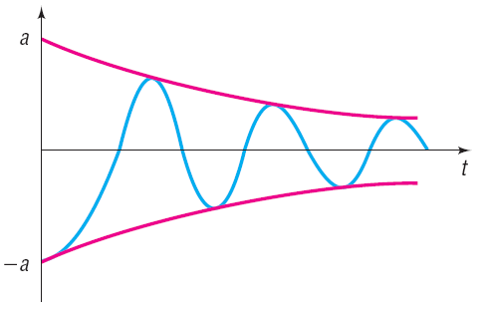
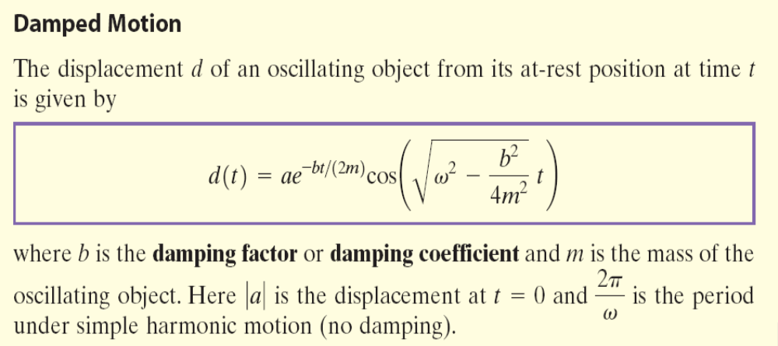
Copyright © 2012 Pearson Education, Inc. Publishing as Prentice Hall.

Slide 12
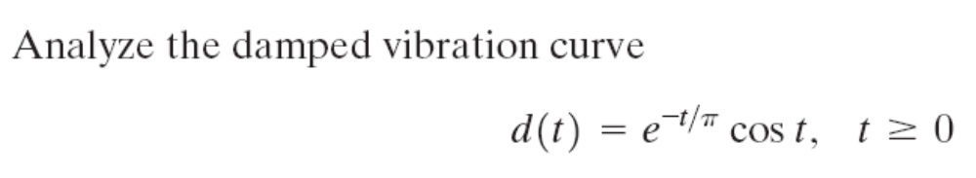
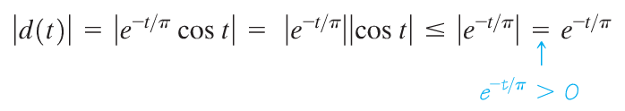

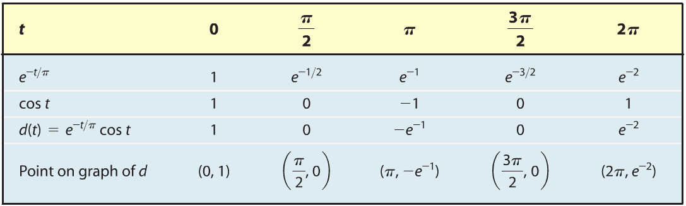
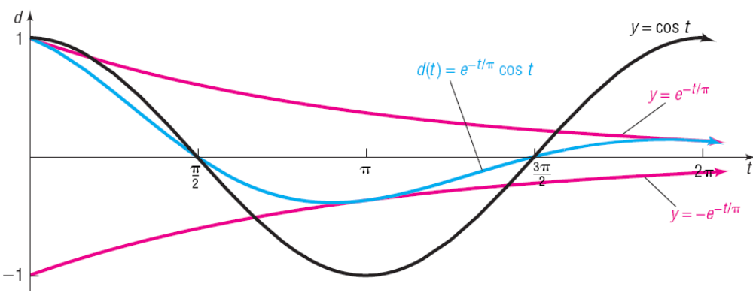
The -intercepts of the graph of d occur when cos t = 0
Copyright © 2012 Pearson Education, Inc. Publishing as Prentice Hall.

Slide 13


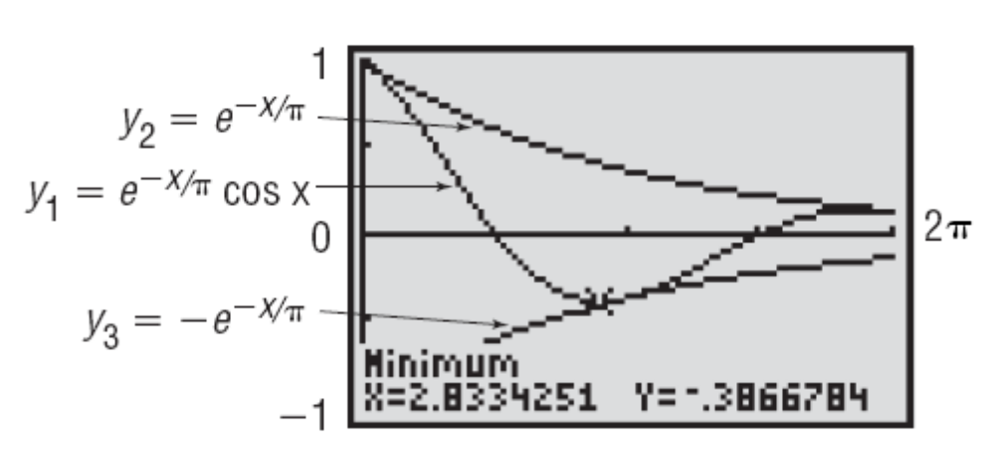
Copyright © 2012 Pearson Education, Inc. Publishing as Prentice Hall.

Slide 14
Copyright © 2012 Pearson Education, Inc. Publishing as Prentice Hall.

Slide 15

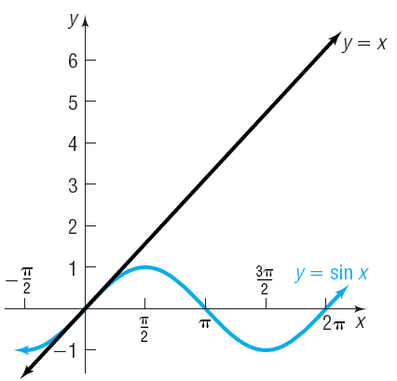
Copyright © 2012 Pearson Education, Inc. Publishing as Prentice Hall.

Slide 16
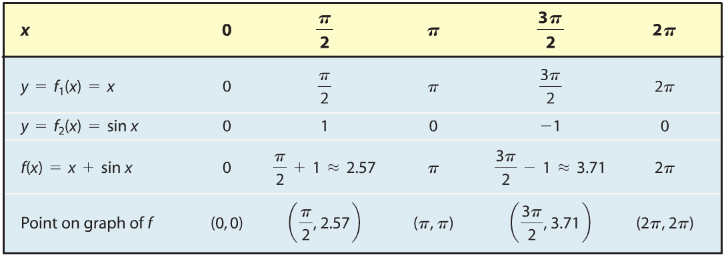
Select several values of x and compute f₁(x), f₂(x) and
f(x) = f₁(x) + f₂(x)
Copyright © 2012 Pearson Education, Inc. Publishing as Prentice Hall.

Slide 17
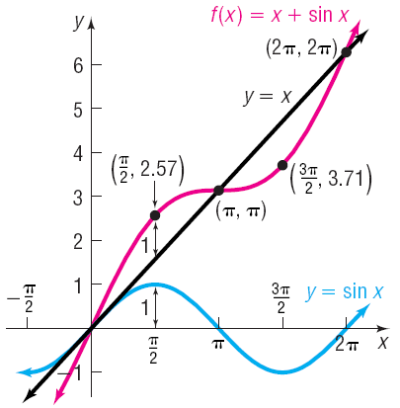
Copyright © 2012 Pearson Education, Inc. Publishing as Prentice Hall.

Slide 18

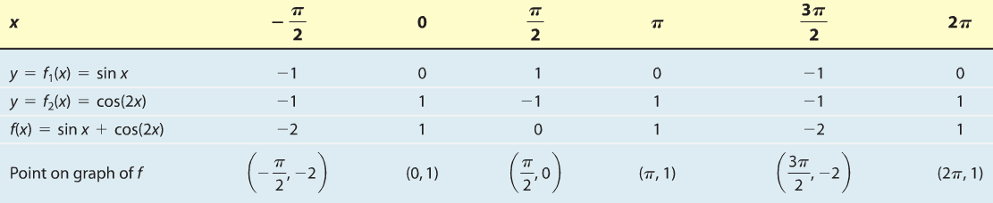
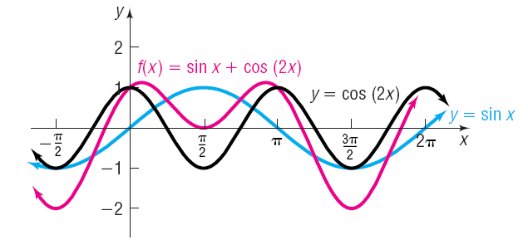
Copyright © 2012 Pearson Education, Inc. Publishing as Prentice Hall.

